Slide 1
Teacher Notes

Slide 3
Symbols
I do: my turn to talk. This is the explanation section of our lesson where you are required to listen.
We do: this is where we discuss or work on the concepts together.
You do: your turn to be involved. You may be working in a group or on an activity individually.

Slide 5
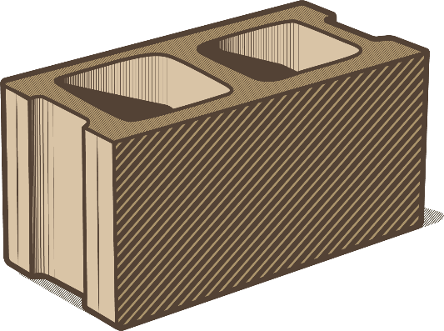
What Are Processed Materials?
All materials are made of matter. Processed materials are made from matter which has been altered and changed by humans. This means the matter cannot occur naturally in any way. It is different from any material formed through natural processes. Some examples of processed materials are:
plastic concrete nylon

Slide 6
Humans as Producers
From the beginning of human history, people have looked to the world around them for ways to simplify repeated tasks. When they realised that natural materials were limited by their physical properties (too brittle, wear out quickly) they began to manufacture new materials by processing them. Materials Science was born and is now a world-leading scientific discipline.

Slide 7
Building Communities
As humans gained more control over the kinds of materials they were processing, factories were established to produce these materials so they were in greater supply. Along with harvesting natural materials, we also mass produced other products to satisfy our need for processed materials. As natural materials became scarcer, we turned to processed materials more and more as they were cost-effective and in seemingly limitless supply.

Slide 8
Stone Cold
For generations, the use of stone in our dwellings meant long-term, secure and hard-wearing homes which were built to last. As societies grew larger, bigger communities began to develop. Sources of good building stone had to be brought in from further and further away. The Macedonians and Romans first realised that chemically reacting various powders with water (cement) produced a hard-setting material which later became known as concrete.

Slide 9
Developing Processed Materials
The field of material science has come a long way from the early days of alchemy and attempting to turn lead into gold. Developments in fibres, building materials, medicines and moulding have led to a brand-new era for humans. Humans now have a longer life expectancy, high rise communities, extravagant wardrobes and disposable objects of any imaginable form. We now live in an age where nothing seems impossible for materials.

Slide 10
Will Processed Materials Last Forever?
Humans kept producing and processing. For a time, it was good. If we needed something new, we acquired it - casting aside the broken, used, outdated and unfashionable objects no longer needed. It was a throw-away society of overconsumption which eventually put us in a troublesome situation. We are dealing with the consequences today.

Slide 11
Processed Materials - True or False?
Put your hands up for ‘true’ and cross your arms for ‘false’.
Discuss your answers as a class.
Plastic is a material found in nature.
Concrete was invented in the 1970s.
Your clothes are made from 100% natural materials.
Plastic bags break down around 100 times slower than paper bags.
Most houses are made from both natural and processed materials.

Slide 12
Processed Materials - Answers
False - Plastic must be manufactured, so it is a processed material.
False - Concrete has been around for at least 2000 years (although between 500 CE and the 13th century, the knowledge for making concrete was lost!)
Probably false (but check your clothing tags just in case) - Cotton and wool are natural, but polyester and nylon are not.
True - Paper bags take about a month to break down, but plastic bags can take 10 years.
True - Woods and many metals are natural in origin, whereas most other construction materials are usually processed.

Slide 13
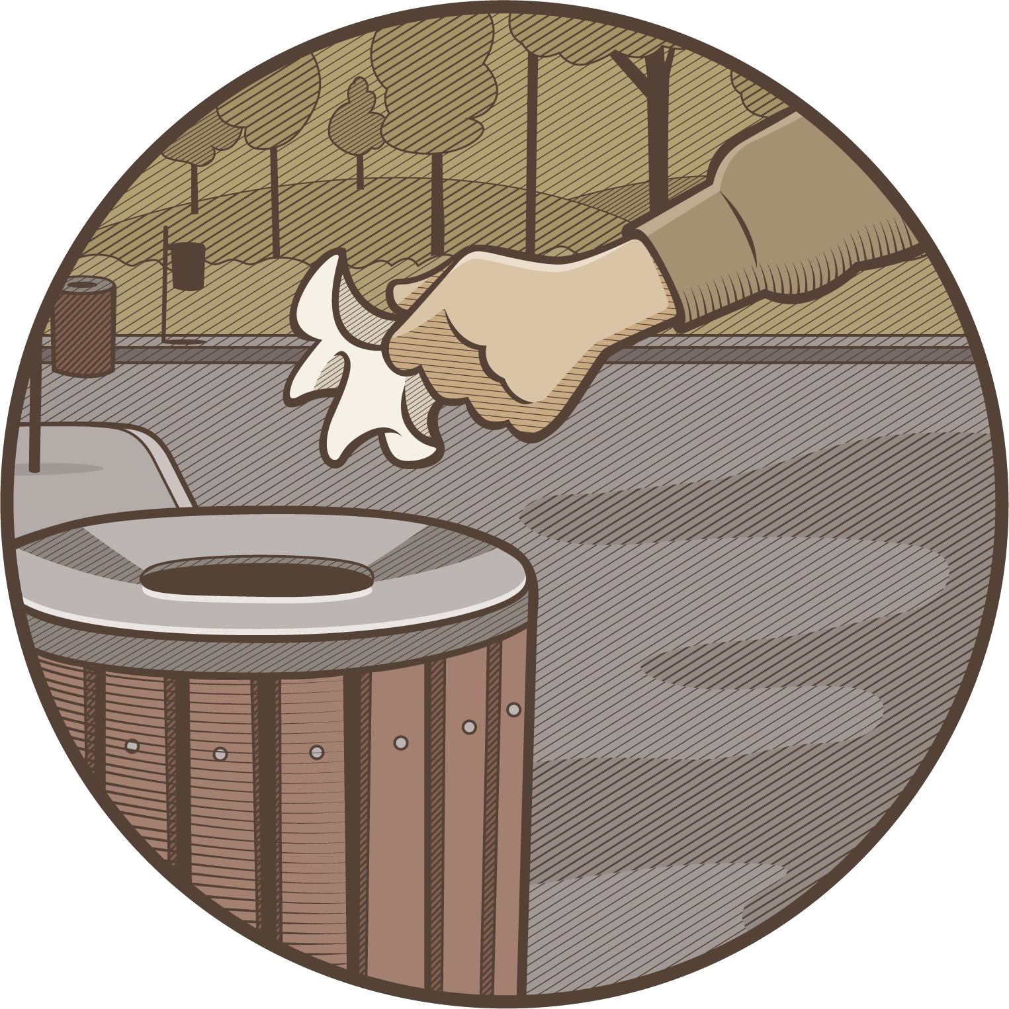
Waste Management Investigation
Waste is one of the most significant environmental issues of the 21st century. Use this Waste Management Investigation to collect, measure and record the waste in one of the classroom rubbish bins in your school.
After analysing the data, design a poster to inform others of the actions they can take to reduce the waste thrown away in their classrooms.

