Slide 1
Teacher Notes

Slide 3
Symbols
I do: my turn to talk. This is the explanation section of our lesson where you are required to listen.
We do: this is where we discuss or work on the concepts together.
You do: your turn to be involved. You may be working in a group or on an activity individually.

Slide 5

Why Do We Do It?
Over the years, humans have devised ways of replacing many of the natural materials we have traditionally used with processed materials. There are pros and cons for both natural and processed materials. Look at fake plastic trees as an example. Inside many homes and offices, you can find fake plastic trees as a substitute for natural trees. They look the same, provide aesthetic value to a room in the same way, some of them even have smells which mimic or copy the natural smells of trees and flowers!

Slide 6
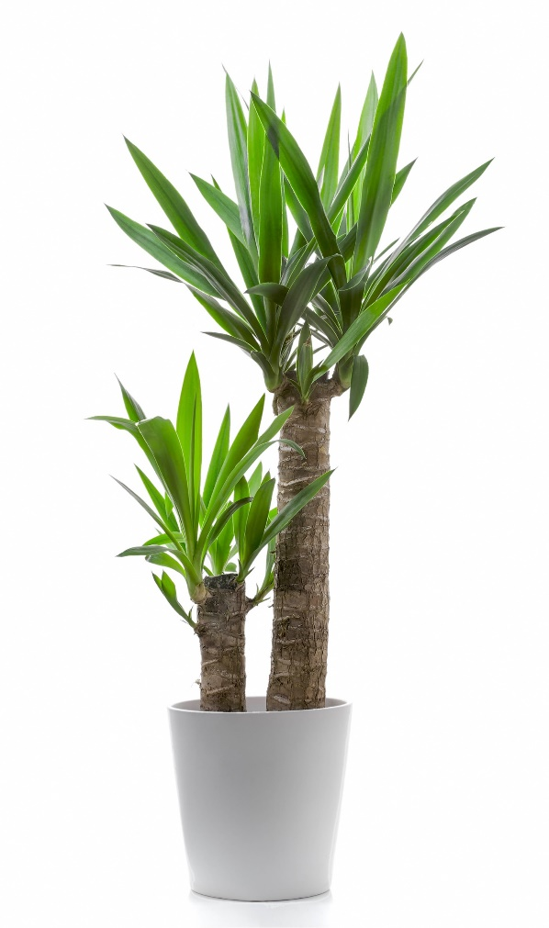
Making the Choice
To decide whether processed trees or natural trees are the best choice for a particular location, we must first look at the reasons behind our choices. Fake plastic trees would be useful for places where maintaining a living plant would be more difficult. Perhaps lack of sunlight and time to care for a living tree make it impossible to choose the natural option. Alternatively, if a living tree can provide something a fake plastic tree cannot, like herbs for cooking or the therapeutic benefits which come from caring for a real tree, the natural option would be best.

Slide 7
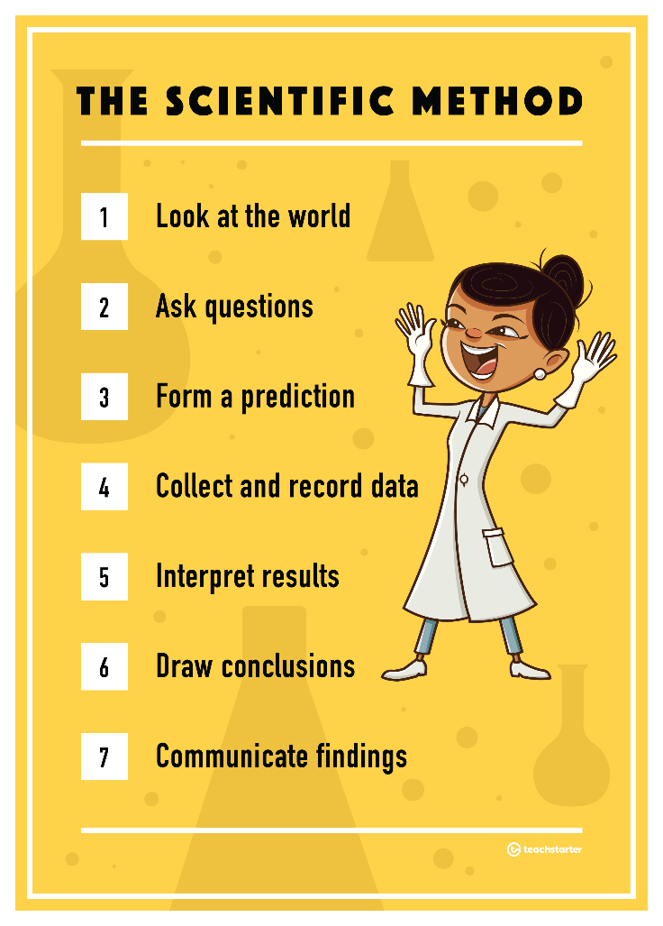
The Scientific Method
Believe it or not, when choices like this are made, people are using a simplified version of the scientific method. People ask questions and form predictions based on their experiences of the world around them, for example, when deciding on the best type of plant to use: real or fake. Many people would simply accept their initial decision, however, a good scientist would go further!
Click the picture to download this poster.

Slide 8





Thinking Like a Scientist
Once a prediction has been formed, a scientist begins to collect, record, interpret and make conclusions about the prediction by performing tests. Then, a scientist communicates their findings by confirming whether their prediction was correct or not.

Slide 9

The Scientific Method in Action
The following video clip is a demonstration of the scientific method in action. Whenever you are performing a science experiment, you should follow these steps in order to come to a scientific conclusion that you can confidently share with others.
YouTube Link to Krazy Kristian’s Science Show

Slide 10
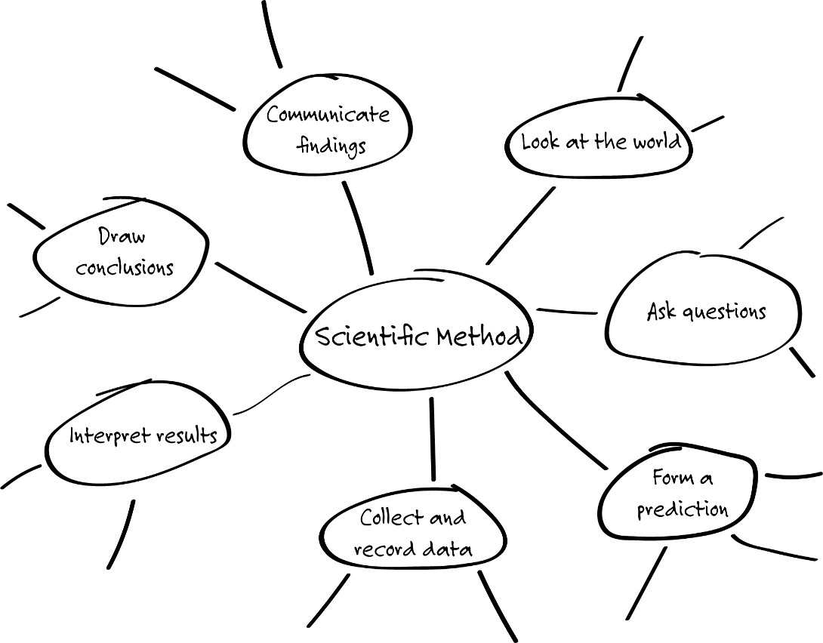
The Scientific Method - Class Discussion
After watching the video clip, make a mind map on the board outlining the steps that Krazy Kristian and Professor Paul took during the experiment. Be sure to include the seven steps of the scientific method in your mind map.

Slide 11
Thinking Scientifically - Individual Task
Look at the world you live in. Think of a decision you would need to make in an everyday situation which could be tested scientifically.
Ask yourself questions about the pros and cons involved in each side of the decision by using the Comparing Pros and Cons Template.
Form a prediction which can be tested scientifically. You may like to use the What's the Use? PowerPoint to help you develop a scientific hypothesis.
Complete the Design Your Own Fair Test Worksheet to help you develop and design an experiment you could use to test your hypothesis.

