Slide 1
Teacher Notes

Slide 3
Symbols
I do: my turn to talk. This is the explanation section of our lesson where you are required to listen.
We do: this is where we discuss or work on the concepts together.
You do: your turn to be involved. You may be working in a group or on an activity individually.

Slide 4


Slide 5

Look at the World
When your mind is blank, it is often the best time to look at the world around you without making judgements. For a scientist, these blank-mind moments allow for pure observations of the world around them to occur. A pure observation is one made without a person thinking about what they are observing. The thinking can come later.

Slide 6

Interpret and Infer
Once you have a deeper sense of the world around you from your observations, you can begin to interpret the data you have experienced. You will start to form inferences based on your experiences. This helps you to understand what you have experienced more completely.

Slide 7

Question Time
Using the data you have available to you, you can begin to interpret and make inferences about your experiences. But, as a good scientist, you may start seeing gaps in your knowledge. You can make guesses about these gaps, but anybody can do that! A true scientist will always test these guesses. The best way to begin this process is by asking questions.

Slide 8

Do the Research
Research comes from sources. These can be classified into primary, secondary and tertiary sources. It is important to have credible research sources and to record your resources whenever you are going to use information from them. It is also a good idea to keep a research summary.
Use the links on this page to access posters and research helpers.

Slide 9
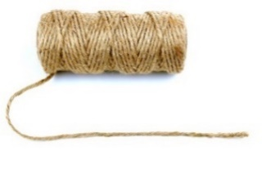
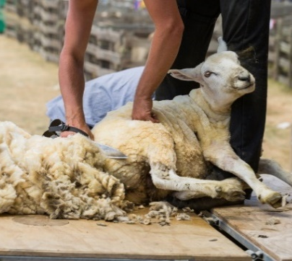

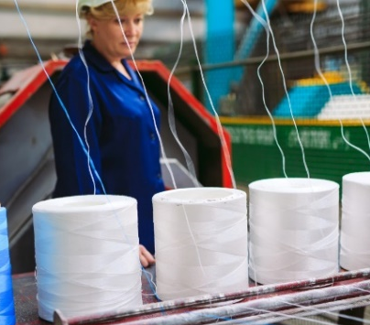
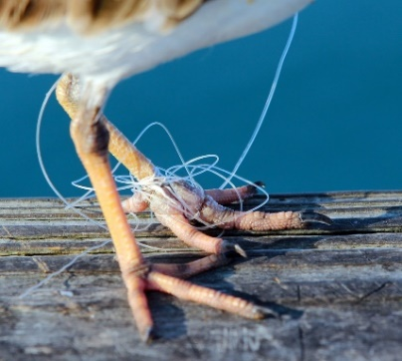
Initiating a Scientific Investigation
Using the Initiating a Scientific Investigation Worksheet, work through the following steps as a class. This will help you to better understand the process we have just examined.
Step 1: Look at the World - Observe the images below. Take simple notes and sketches in the blank space on the worksheet. Remember, don’t think… just observe!

Slide 10
Initiating a Scientific Investigation
Step 2: Interpret and Infer - Now that you have seen the images and recorded some of your observations, it is time to make inferences (smart guesses) about your observations and interpret the information.
Use the blank space on the worksheet to draw a mind map (or similar) to record your thoughts in a way which you can easily understand.

Slide 11
Initiating a Scientific Investigation
Step 3: Ask Questions - In the infer and interpret stage, you will come across certain unknowns which cannot be answered through the information you have, either in your observations or your knowledge.
Record these unknowns in the form of questions on your worksheet. You should include at least three different questions to choose from when you begin to plan an experimental investigation.

Slide 12

Do the Research – Independent Activity
From the three (or more) questions you have recorded on your worksheet, choose the one question which most interests you. Research your topic and question to discover more about it. Use the following worksheets to guide your research.
Research Notes Template
Research Summary Template

