Slide 1
Teacher Notes

Slide 3
Symbols
I do: my turn to talk. This is the explanation section of our lesson where you are required to listen.
We do: this is where we discuss or work on the concepts together.
You do: your turn to be involved. You may be working in a group or on an activity individually.

Slide 5
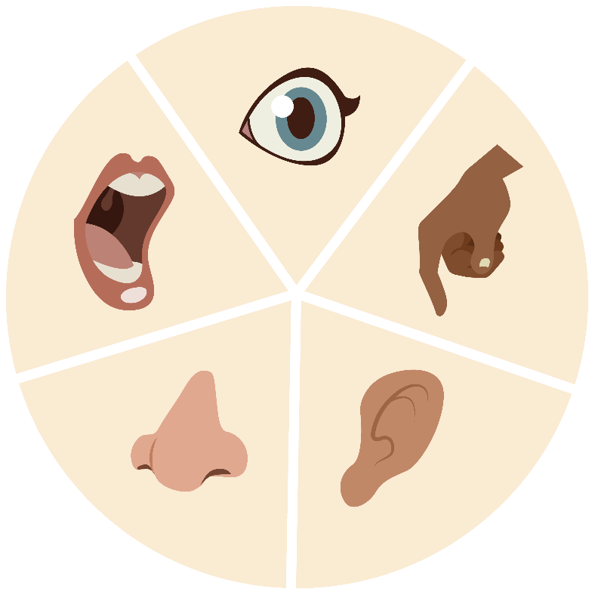
What Are Materials?
We experience the world around us using our five senses.
These are touching, smelling, hearing, tasting and seeing.
These senses interact with the matter that our world is made from.
A material is the type of matter that an object is made from.

Slide 6
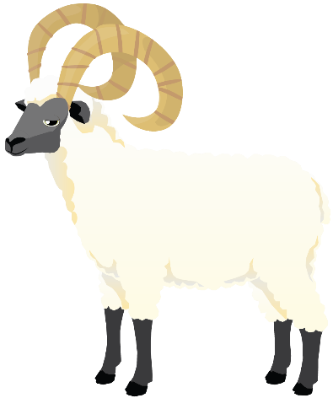
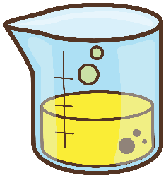
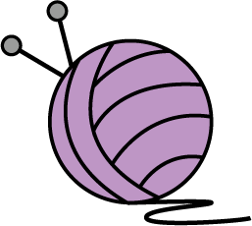
Types of Materials
Materials can be classified into two distinct groups: natural materials and processed materials. Natural materials are unchanged from the way they have been formed in nature. Processed materials have been altered in some way by people.
Wool is a natural material.
Nylon is a processed material.

Slide 7
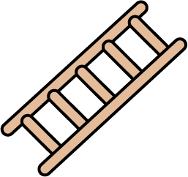
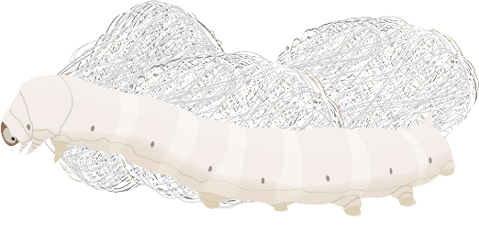
Natural Materials
Natural materials can be roughly classified into two categories: those which come from the earth and those which come from living things. Materials from the earth include stone, metals and minerals. Materials from living things include silk, leather and wood.
Natural materials from the earth | Natural materials from living things
silk
metal
stone
wood
leather
minerals

Slide 8
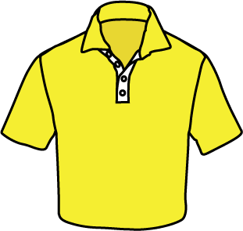
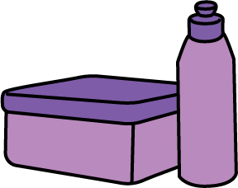
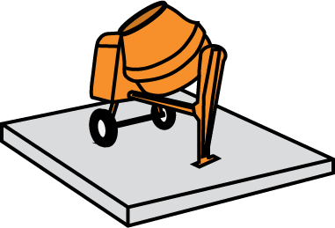
Processed Materials
Processed materials have been created by people to serve a purpose. While many natural ingredients may be used in the creation of a processed material, the final product cannot be produced without human intervention. Examples of processed materials include plastics, synthetic fibres and concrete.
plastic containers
polyester clothing
cement and concrete

Slide 9
A Note About Components
When we are discussing materials, we are talking about the matter that one particular item is made from. Many items are made up of different objects or ‘components’, which may be made from different matter.
For example, a child’s toy might be made from a combination of wood, metal and plastic.
Another important thing to note is that even though humans change the shape of many materials by carving or weaving, the materials themselves don’t change. Wool is still wool, whether it is on a sheep or knitted into woolly winter socks!

Slide 10
Revising Materials - Class Activity
On the board, make a table with two columns. One column is for natural materials and one column is for processed materials.
Add as many different materials to the table as possible. Discuss any differences of opinion as a class.
Natural Materials | Processed Materials

Slide 11
Object Investigation - Independent Activity
Choose a manufactured object that you can see in the classroom. Select an object that is made of at least three different materials.
Using the Object Material Investigation Worksheet, identify the materials used, their source (where they have come from) and why this material was chosen to make the object.
For example: This object is made out of wood, which comes from trees. Wood is hard and strong.

