Slide 1
Teacher Notes

Slide 3
Symbols
I do: my turn to talk. This is the explanation section of our lesson where you are required to listen.
We do: this is where we discuss or work on the concepts together.
You do: your turn to be involved. You may be working in a group or on an activity individually.

Slide 5
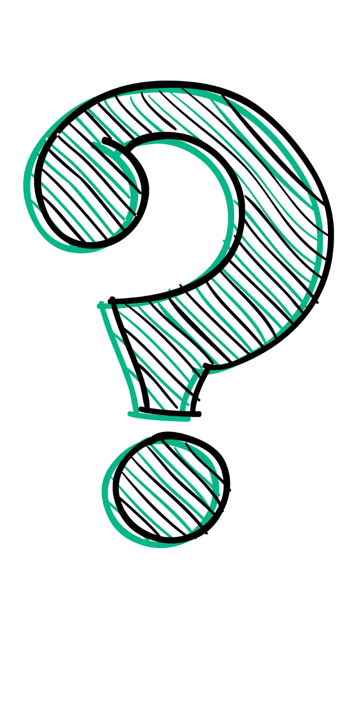
Why is a Conclusion Important?
One of the most overlooked parts of any scientific experiment is the conclusion. It is very easy to complete an experiment, look at the data, understand what has happened and then leave it at that. But the real reason for conducting any experiment is to present a valuable conclusion. This explains that the experiment either proves or disproves a hypothesis.

Slide 6
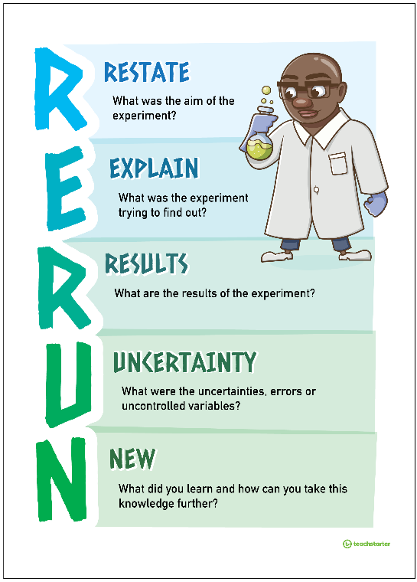
R.E.R.U.N.
One way to make sure that you have covered all the points you should be making in your conclusion is to remember the R.E.R.U.N. acronym.
Restate: What was the aim of the experiment?
Explain: What was the experiment trying to discover?
Results: What are the results of the experiment?
Uncertainty: What were the uncertainties, errors or uncontrolled variables?
New: What did you learn? How can you take this knowledge further?

Slide 7

Restate
At the beginning of your conclusion you should briefly state the reasons why the experiment was undertaken. This section can be a single sentence in the form of a statement.
Example: The purpose of the experiment was to see how sunlight affects plant growth.

Slide 8

Explain
After you have restated the purpose of the experiment, you should write out your hypothesis again. What were you trying to find out? Briefly outline the steps that you took.
Example: The hypothesis states that plants need sunlight to grow. Groups of plants were grown in full sunlight, under artificial light and in complete darkness. The height of the plants was measured over time.

Slide 9

Results
You should now explain the results, commenting about what the results from the experiment tell you. Was the hypothesis supported by the data you gathered throughout the experiment?
Example: The hypothesis that plants need sunlight to grow was not supported by the collected data. The graph shows that, at each point in time, all three groups of plants grew.

Slide 10

Uncertainty
Uncertainties or errors that you could not control (such as equipment errors or weather irregularities) should be mentioned as they may have affected the results. Explain how the procedure might be improved to reduce errors the next time it is conducted.
Example: It is uncertain whether there are other variables which affect plant growth. Why did the groups of plants grow at different rates? A possible error in the experiment was that the weather was very cloudy during the testing period.

Slide 11

New
Finally, identify new information you learned or discovered during the experiment. Did the experiment raise any questions? From what you now know, how can you take this knowledge further? Make sure you are using the correct scientific vocabulary in your statements.
Example: Based on the data collected, sunlight isn’t necessary for plants to grow. To further this experiment, it could be tested whether sunlight affects the rate of growth in plants.

Slide 12

R.E.R.U.N. - An Example
Combining the examples from this presentation, a good conclusion would look like this:
The purpose of the experiment was to see how
sunlight affects plant growth. The hypothesis states
that plants need sunlight to grow. Groups of plants were
grown in full sunlight, under artificial light and in complete
darkness. The height of the plants was measured over time. The hypothesis that plants need sunlight to grow was not supported by the collected data. The graph shows that, at each point in time, all three groups of plants grew. It is uncertain whether there are other variables which affect plant growth. Why did the groups of plants grow at different rates? A possible error in the experiment was that the weather was very cloudy during the testing period. Based on the data collected, sunlight isn’t necessary for plants to grow. To further this experiment, it could be tested whether sunlight affects the rate of growth in plants.

Slide 13
A Combined Conclusion - Class Activity
Work together as a class to write a conclusion using the R.E.R.U.N. method and the following experimental data:
Hypothesis: The longer a drive, the sleepier a driver gets.
Test: One student sitting in a chair with their hands on an imaginary steering wheel. Questioned on sleepiness after 5, 15 and 30 minutes.
Results: Scale 1 to 10 on sleepiness. 5 minutes = 2, 15 minutes = 4, 30 minutes = 8.
Uncertainties: Not an accurate car simulation, lots of classroom interruptions.

Slide 14

Independent Task
For a science experiment you have been working on, complete the conclusion using the R.E.R.U.N. method. Remember you cannot complete this section until your work is all complete, data is thorough and easily seen and any diagrams and graphs are drawn and accurate.
It is a good idea to plan your conclusion first before writing it directly onto the worksheet.

Slide 15
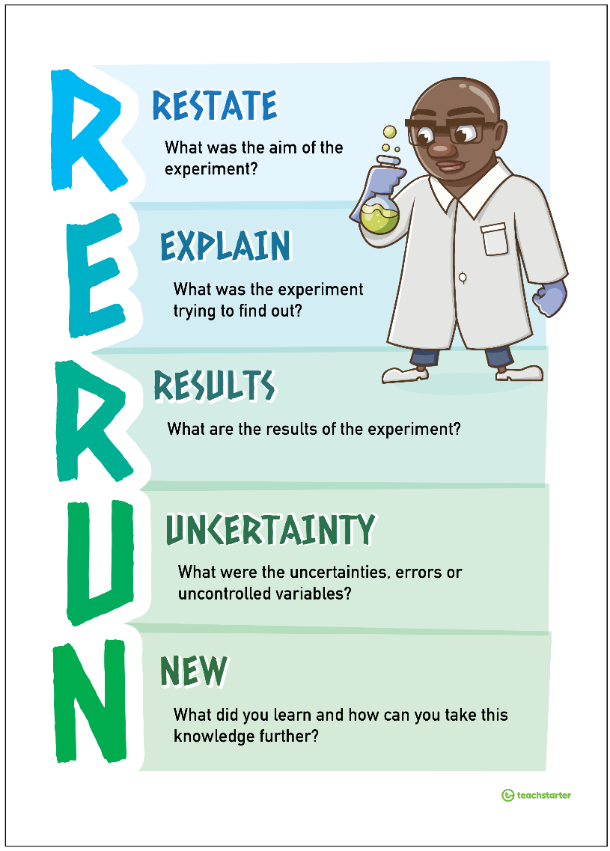
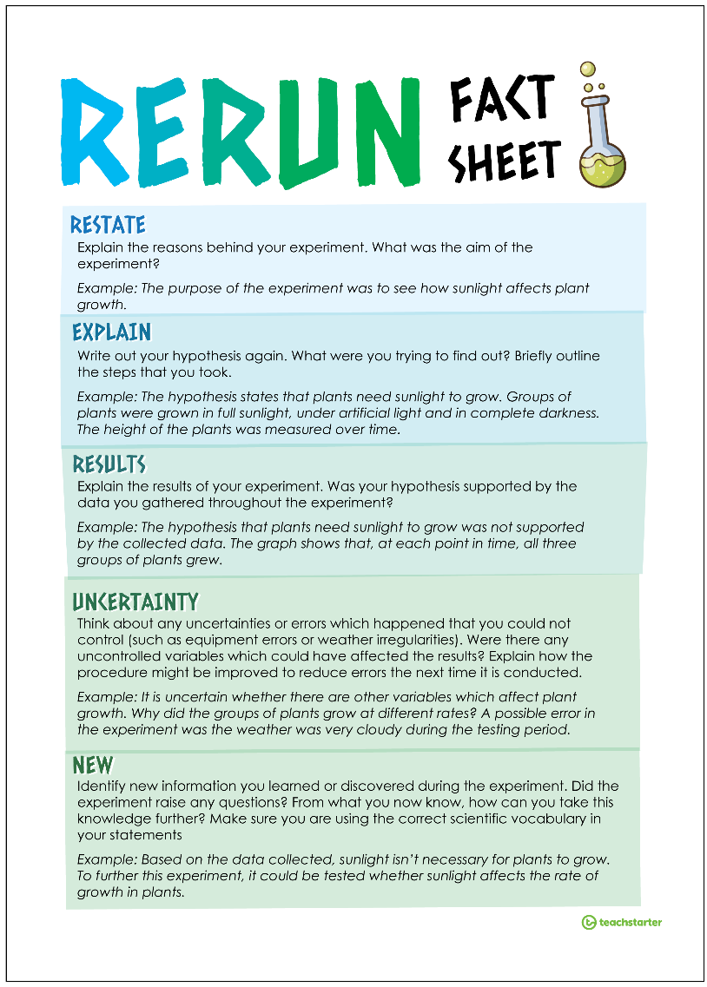
Download Poster
Download Fact Sheet
Return to Presentation

